Slide 1
LiveWELL Champion Toolkit

Slide 2
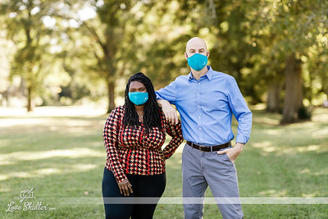
Thank you!
Thank you for taking on the role as a LiveWELL Champion! This is such an important role and your passion for inspiring teammates to live their best lives will make a difference in not only our teammates' lives, but those of our family and friends as well.

Slide 3
LiveWELL Champion Toolkit
This toolkit is a source of program information you can use to educate your teammates about LiveWELL. Click each box below to view the content in each section.
Champion Role
Get Started with LiveWELL
Navigating LiveWELL with your Team
FAQs
Host a LiveWELL Activity
Champion Resources
Department Participation Data
Using Yammer as a Participation Tool
Compassion Champion
Champion Incentive Form and Team Interest Survey
Build a LiveWELL Board
Well-Being Dimensions and Incentives

Slide 4
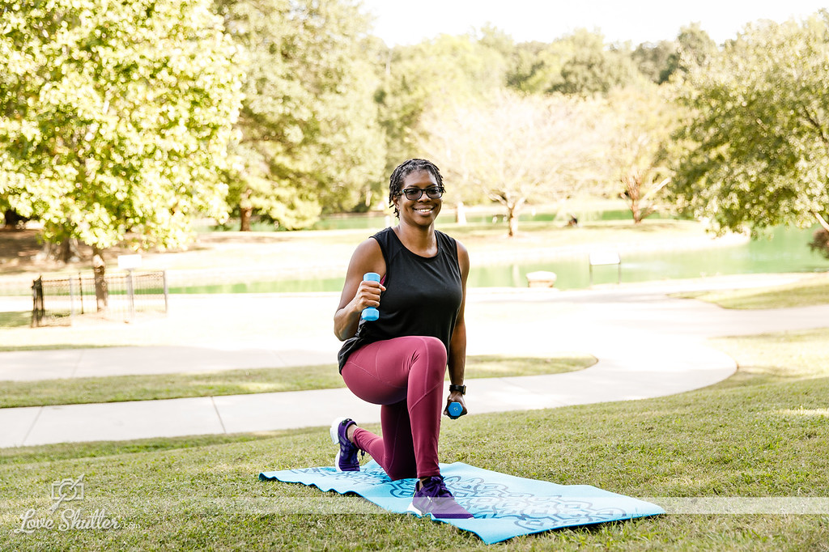
The LiveWELL Champion Role
A LiveWELL Champion:
Is passionate about living a healthy life and inspiring others.
Informs department at weekly/monthly huddles of LiveWELL updates and incentive information. Keeps the conversation inclusive and about all teammates being their best selves by engaging in LiveWELL. LiveWELL is for ALL!
Creates LiveWELL events for your team.
Attends the monthly LiveWELL Champion updates call.
Encourages healthy catering guidelines for meals in the department.
Is an active contributor to the Yammer Champion group page.
Highlights LiveWELL dates to remember, events and well-being resources each month for teammates.

Slide 5
Getting Started with LiveWELL
Share this short video with new teammates or teammates looking for a refresher on navigating LiveWELL. Include link to video on LW site

Slide 6
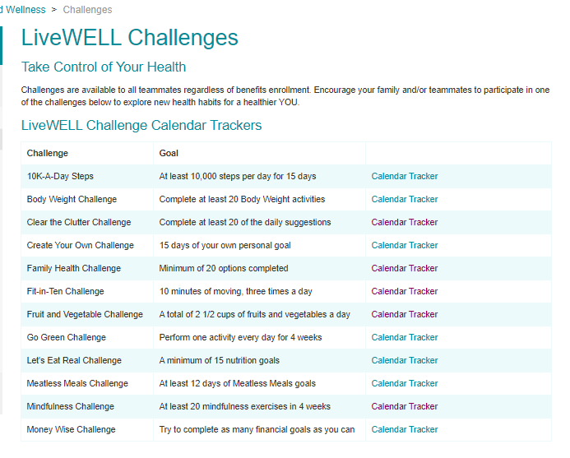
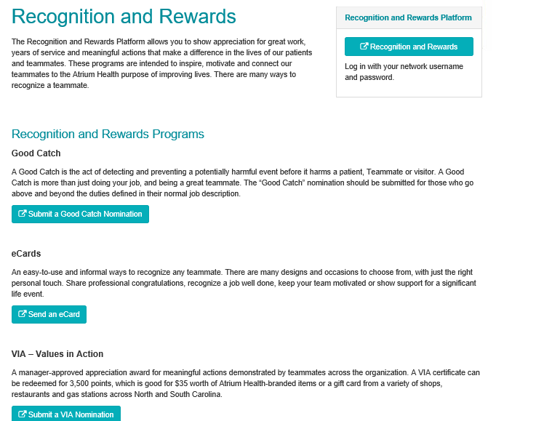
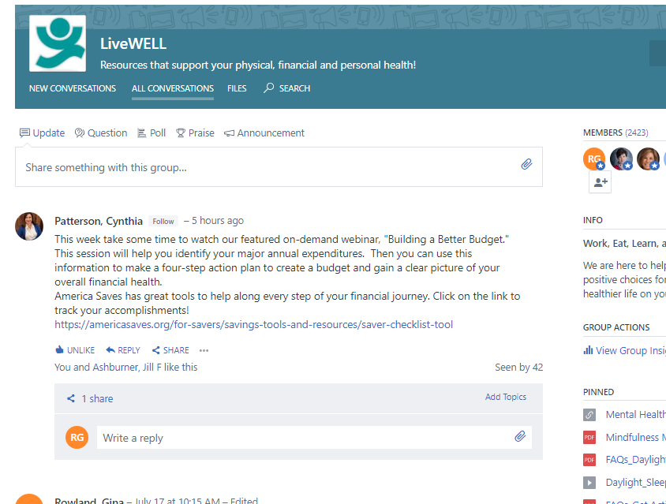
Navigating LiveWELL with Your Team
Create a common LiveWELL space for teammates. This can be virtual and/or on-site.
Virtual: Learn how to set-up a LiveWELL channel in Microsoft Teams
On-site: Learn about LiveWELL boards
Encourage your team’s participation through a monthly event. Find a LiveWELL event checklist here. Find more challenges on the Challenges page.
Recognize your team’s participation. Use the Recognition and Rewards platform to send eCards.
Promote your team’s LiveWELL activities through your LiveWELL board, Teams channel, huddle announcements and Yammer.

Slide 7
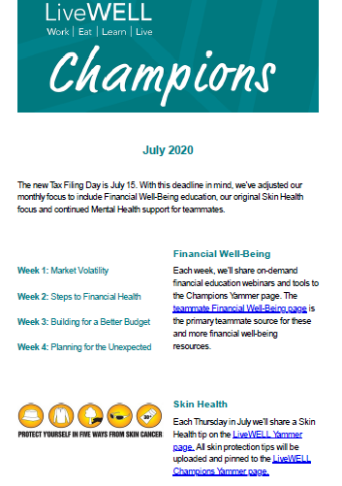
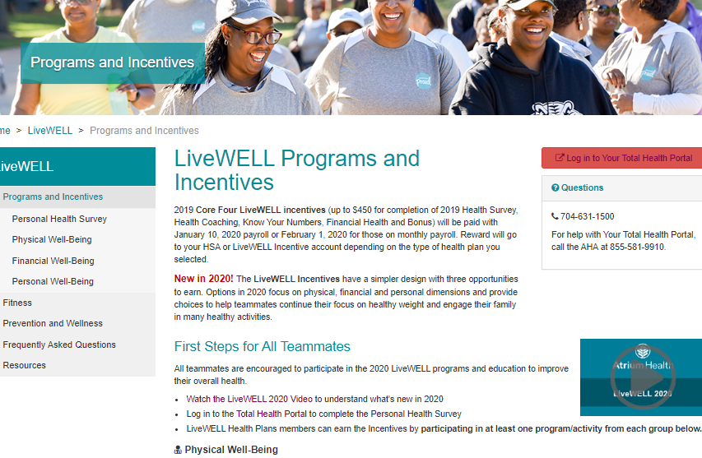
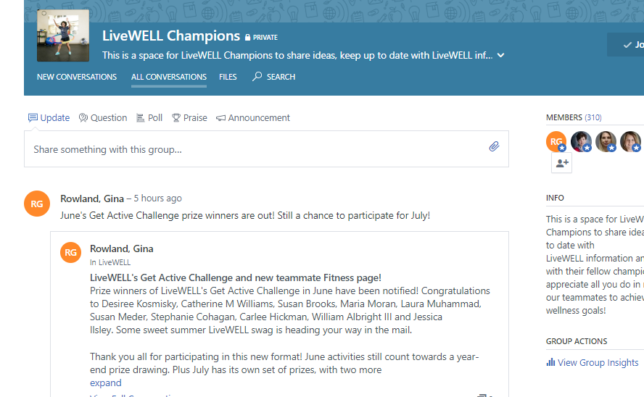
LiveWELL Champion Resources
Monthly, shareable newsletter sent to your inbox.
The LiveWELL teammate web page features program video webinars, resources and tools.
Yammer
LiveWELL Champions: post questions and find additional resources
LiveWELL: find weekly resource highlights and well-being tips.
Teammates use the Total Health Portal to complete their Health Survey, submit incentive completions and challenge activity, schedule Health Coach sessions and check rewards.
The LiveWELL calendar features monthly well-being themes.
The monthly Champions call. A link is emailed and posted to the Champions Yammer group. The call is recorded.

Slide 8
LiveWELL Champion Resources
Partner with peers who can help:
Your teammates. Chances are some teammates are passionate about well-being. Survey your team for interests and ask if they’d like to get involved.
Your Leader. Leaders receive a site/department-specific report on LiveWELL incentive participation monthly. Work with your Leader to identify opportunity areas of participation.
Your LiveWELL HR Team and fellow LiveWELL Champions. Post a question to the LiveWELL Champions Yammer group, or the monthly Champions call.
Compassion Champions
Champion Tip: Set a monthly touch-base with your Leader to review participation. Ask for a recurring time where teammates can meet to complete LiveWELL incentives.

Slide 9
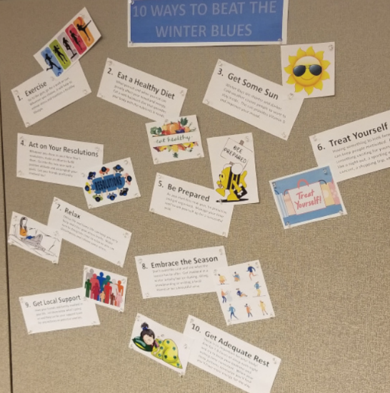
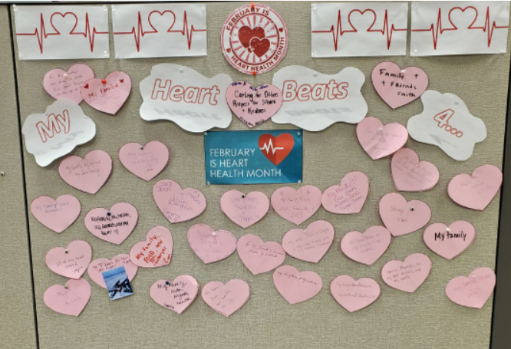
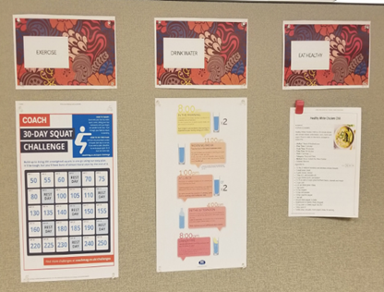
Build a LiveWELL Board
A LiveWELL team board serves as a visual display of LiveWELL information and encourages teammate engagement. Think of your board as a visual motivator. What are some common interests of the team? Is there opportunity to overlap with well-being? Things to consider:
Have a well-being theme
Feature a well-being event or challenge
Include teammate stories or testimonials

Slide 10
Build a LiveWELL Board
If on-site, find a common team area outside of safety concerns. Confirm the use of this area with your Leader.
If working remotely, consider using Teams to create a virtual LiveWELL channel.
To meet everyone where they are, creating both options for your teammates may be useful.
Next:
Find team interests through a team survey.
Use your resources.
Share on the Champions Yammer group!
Champion Tips:
Does the board have a theme? An activity or challenge, a well-being focus or motivational quote are great starters.
Have you highlighted content you consider most important?
Be aware of including too much
Ask yourself, what do I want to make most visible?
It can be powerful to document the experience of your group.
If you have time, “test” the board with your teammates.

Slide 11
Host a LiveWELL Activity
A LiveWELL activity supports teammate engagement. We encourage you to plan one activity per quarter using Champion resources. Here are a few examples to get started:
On-site:
Group walk or exercise session outdoors
Scheduled stretch breaks
Walking meeting outdoors
Volunteer project through Community Benefit
Virtual:
Healthy lunch-and-learn
Group fitness session
LiveWELL Challenge
Healthy media (book, podcast, docu-series) club
Use the Microsoft Teams webinars to set up your LiveWELL channel.
If on-site, follow Covid-safe guidelines for group gatherings. Outdoors options include facility walking trails, available on the LiveWELL resources web page.

Slide 12
Host a LiveWELL Activity: Checklist
Identify the activity. Survey your team regarding interests and availability. This survey template is available to use and edit for your team. Microsoft Forms in Office 365 can help build a survey as well. Once in Microsoft Forms, click the question mark icon in the top right corner for a step-by-step guide.
Review the activity with your Leader. Consider safety guidelines, time commitments, facility approvals, supplies and additional support needed.
Pick a day, time and location. Aim for 4 weeks prior to the event.
Reserve your space and equipment if needed.
Announce in a team huddle and send a calendar invite.
Gather participant information. Place a sign-up sheet in on your LiveWELL board and/or Teams channel.
Encourage team participation. Huddle announcements, your board, email and Teams chat.
Confirm and purchase supplies needed
Activity prizes: work with your Leader to determine if Teammate Proud Store items can be purchased.
Miscellaneous items specific to event.
Share your team story on the LiveWELL Champions Yammer page.
Encourage your teammates to post on the LiveWELL Yammer page and other relevant Yammer groups.
Find more resources on how to use Yammer.
Evaluate. Follow up with your teammates for feedback and recommendations.

Slide 13
Compassion Champions
Compassion Champions are an extension of LiveWELL Champions (some of you may be both). Preventing Compassion Fatigue, providing Code Lavender Events and assisting teammates to resilience resources are the main roles of compassion champions. Compassion Champions can also receive incentive credit for Personal Well-Being as LiveWELL Champions by completing a self reported set of questions in their LiveWELL portal.
Compassion Champion-Code Lavender Information
Connect with Compassion Champions on Yammer

Slide 14
Using Yammer
Yammer can be a great internal social tool for teammates to connect, share experiences and get involved. We encourage you to share your team’s activities and achievements. This can also foster inspiration for others!
Atrium Health’s Yammer Q & A Group has info on how to use Yammer on desktop and your phone, and even create your own private Yammer group for your team. Plus, a new add-in feature to Microsoft Teams. If you can’t find what you’re looking for, post a question to the group.
You can find additional instructions for setting your desktop and phone through Microsoft Support.

Slide 15
Forms and Surveys
Teammate Interest Survey: this template in Office 365’s Microsoft Forms is available to use or edit for your team. For further guidance in building your own survey, log-in to Office 365 and select the Microsoft Forms icon. Click the question mark icon in the top-right corner for a step-by-step guide.
Champion Incentive Credit: To ensure you receive your Champion incentive credit, review the instructions on how to submit your information through the Total Health Portal.

Slide 16
Engagement- LiveWELL on Teams
Create a LiveWELL Teams Channel on for your teammates. All teammates have access to Teams. Teams is a way to collaborate, communicate and organize information for your teammates. Your LiveWELL Teams space can be an open forum for chat, questions, informal gatherings, challenge check-ins, you name it!
This webinar shows how to set up a team, create channels and organize files. Note: this is a SharePoint link.
This webinar shows how to schedule and launch meetings in Teams. Learn how to send invites to your teammates, assign presenter and attendee roles. Note: This is a SharePoint link.
Encourage teammates to download the mobile app to connect on-the-go.
Meetings are fully interactive with audio, video and screen sharing.
If in-person, meet outside when possible. Facility walking trails are available on the LiveWELL resources web page.

Slide 17
Departmental Participation
Leaders will receive LiveWELL Participation reports around the 15th of each month. Please work with your leader to increase participation in LiveWELL. We will continue to post the system chart on the LiveWELL Champion Yammer site every month.

Slide 18
FAQs
Click this link to access a comprehensive list of Frequently Asked Questions. If you still need assistance, feel free to call the HR Service Center at (704) 631-1500 or email LiveWELL Events at LiveWELLEvents@atriumhealth.org
https://teammates.atriumhealth.org/livewell/frequently-asked-questions

Slide 19
LiveWELL Programs and Incentives
LiveWELL programs and incentives support the three pillars of well-being: Physical, Financial, and Personal
All teammates have the opportunity to participate in LiveWELL and share in a consistent experience
Assess Your Health (Personal Health Survey)
Physical | Financial | Personal
Incentive Eligible Programs: Complete your Annual Wellness Exam (includes appropriate labs, weight/height, blood pressure, glucose, cholesterol) Work with a Coach on your Prevention Action Plan Engage in LiveWELL recommended Care management program (Medcost/Omada) Engage in Medical Nutrition Therapy (enrolled teammates are eligible for up to 6 visits with a Registered Dietitian) | Incentive Eligible Programs: Financial Education Classes/Consultations or Webinars One-on-One Rx Medication Management Advanced Directives Webinar Complete a session with your Personal Financial Advisor | Incentive Eligible Programs: Work with an Accountability Coach on personal goals Complete a personal well-being webinar offered by LiveWELL Be an active LiveWELL champion or compassion champion in your department Complete and log 4 Volunteer Hours with Atrium Health Serves. Physicians and APPs- complete the Well Being Index Complete the 8 hour MHFA training class Compete the Atrium Health Diversity Certificate (application and acceptance required) Complete an accredited weight loss or weight management program (example WW or Carolinas Weight Management)
Start Here

Slide 20
LiveWELL Incentives
Teammates earn incentives by participating in at least one activity for each well-being category of physical health, financial health and personal health.
Cash incentives are paid into a LiveWELL Health Plan account for teammates enrolled in a LiveWELL health plan:
2021 LiveWELL Incentives
Health Plan | Physical | Financial | Personal | TOTAL
Individual | $225 | $225 | $225 | $675
Family | $450 | $450 | $450 | $1,350
Deadlines | Contributions (bi-weekly payroll) | Monthly Payroll
March 8 | April 16 | April 30
June 14 | July 23 | July 30
October 18 | November 12 | December 1

Slide 21
Completed Incentive Screen Shot

